Slide 1
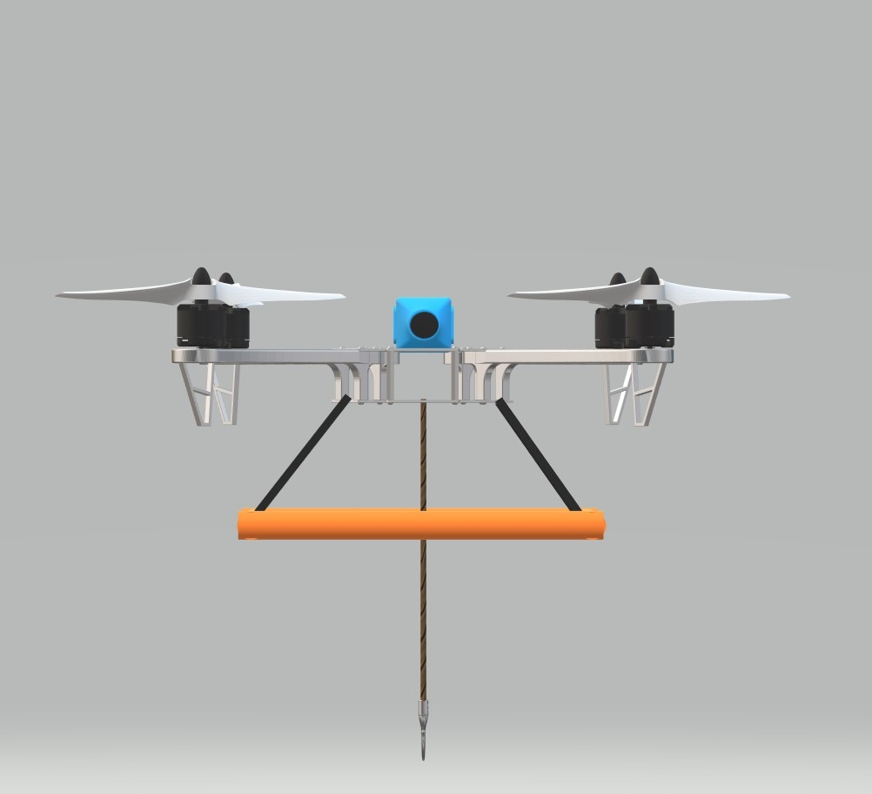
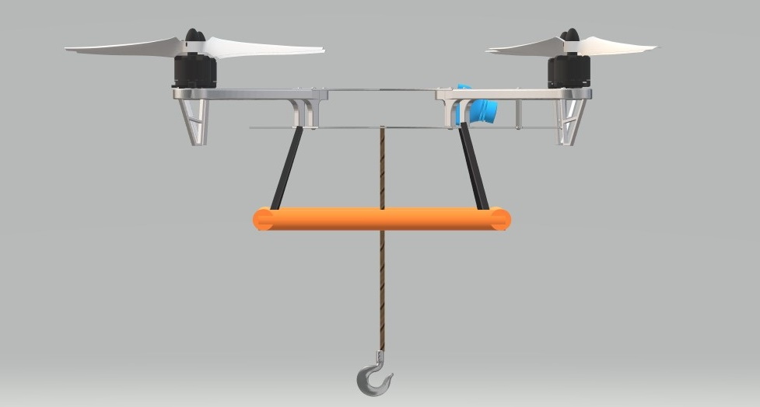
Infographic Resume
Fishing Drone
Technical Project Data
Components
Drone Motors
Propellers
Drone Frame
Fishing Hook
Fishing Wire
Drone Controller
Camera
Electrical & Wirings
Mounts and Joints
Base Frame
Supporting Frame
Screws and Fittings
Rendered Pic (Front)
Fishing is currently done by two ways either by using fishing boats trawlers or by sitting on lake shores. Majority of fishes as well as large fish usually reside away from shores in lakes as well as in the seas. So here we propose a unique fishing drone that is incorporated with a floating panel allowing it to land and sit in water with a fishing hook and fly away with the caught fish onto the shore.
Advantages
Ability to fly to any corner of lake as per the fisherman
Water landing ability
Catch fish in the deep sea while sitting on sea shore
No risks of using boats for fishing
Fly away with caught fish instantly
Easy to operate and use
How Does it work
The drone makes use of 4 drone motors along with 4 propellers to enable flight on the drone. We use a controller to manage drone flight and stability in motors.
The controller is integrated with esc’s to manage motor speeds and achieve desired flight.
The drone is integrated with a camera for viewing live footage on an android phone. The camera footage is wirelessly transmitted to the user phone.
The user operates a rf controller to control the drone wirelessly. The movement commands transmitted by remote are received by the drone receiver and the controller operates the motors to operate the drone flight.
Disadvantages
Needs battery charging after 3-4 fish Catches
Cannot catch very large fish
Requires flying training
Rendered Pic (Side)

Slide 2
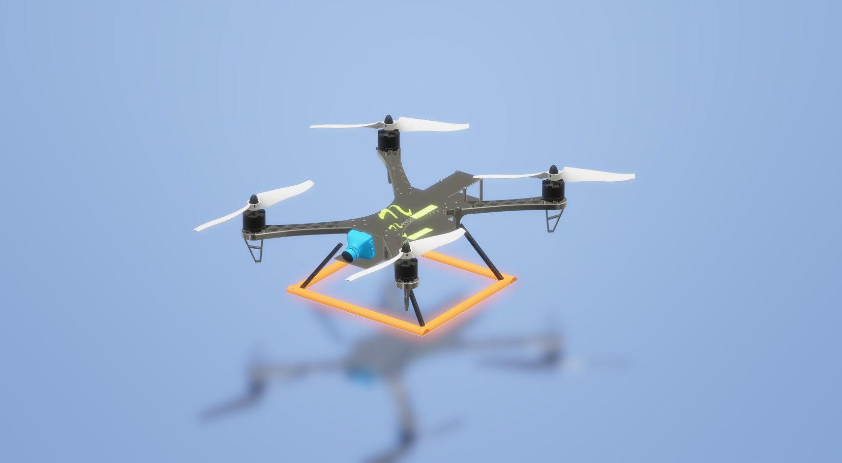
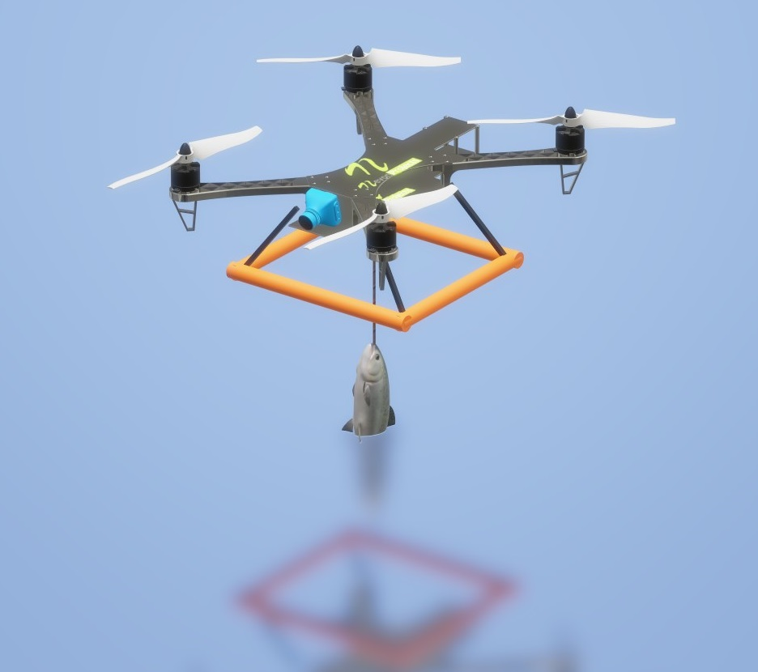
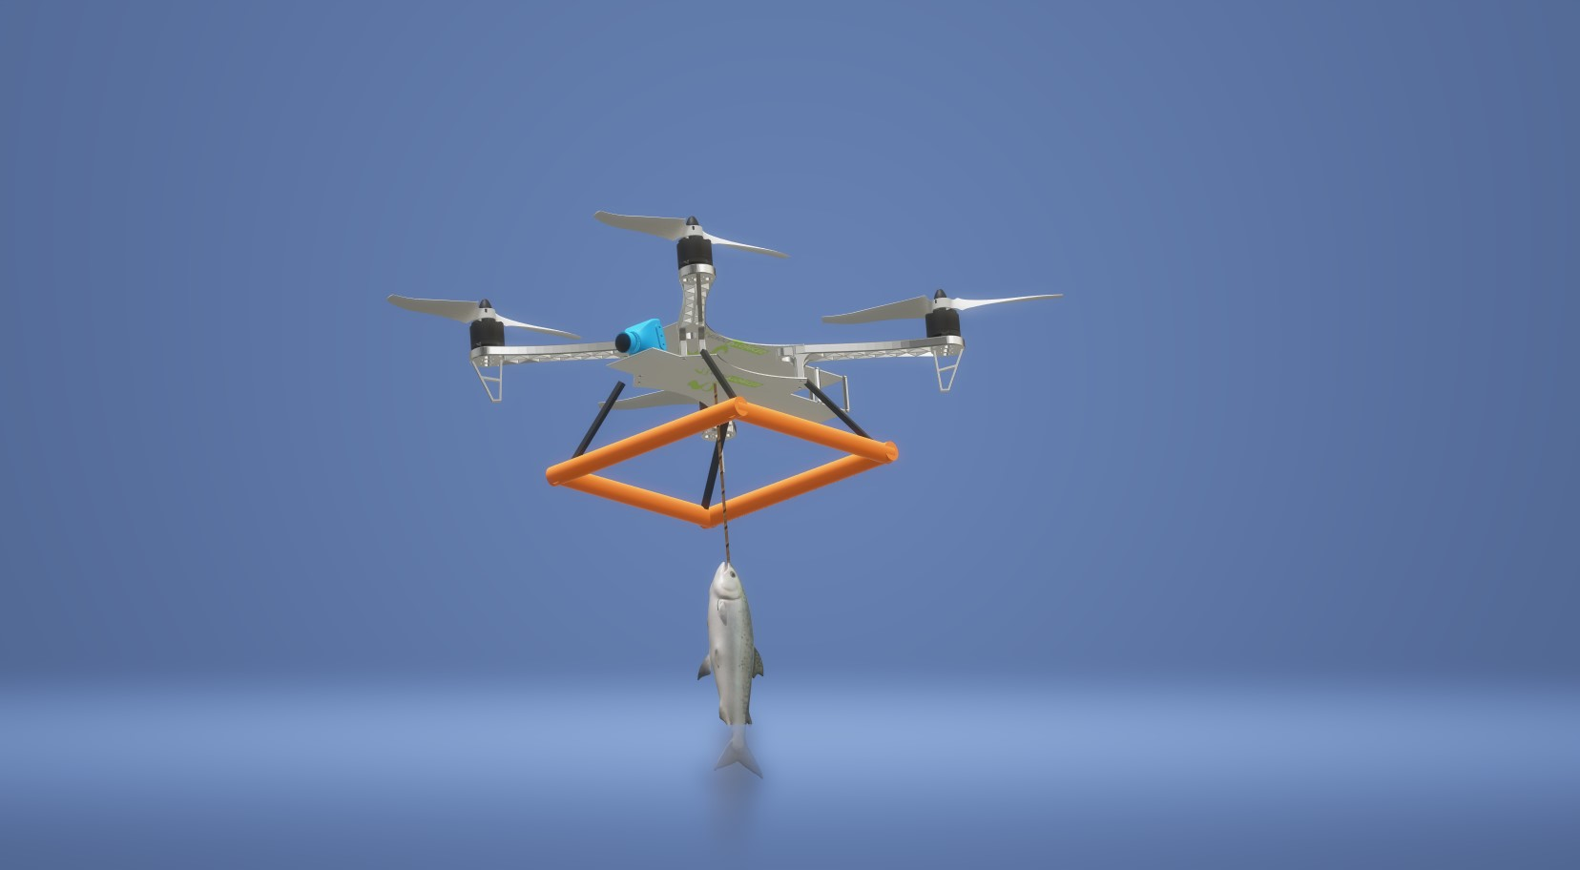
Renders (3D)

Slide 3
Bill of Materials Major components – Drone Motors , Drone Frame , Drone Controller , Propellers – Rs 2300 Fishing Hook – Rs 150 Fishing Wire – Rs 130 Camera – Rs 600 Readily available components - Electrical & Wirings Mounts and Joints Base Frame Supporting Frame Screws and Fittings
Responsibilities
MDM18B008
Planning
Implementation
Assembly
MDM18B011
Design
Setup
Assembly
MDM19B042
Design
Setup
Assembly

Slide 4
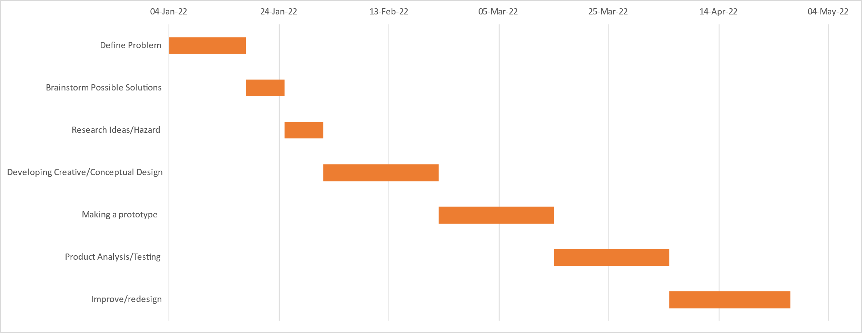
GNATT Chart
Task | Time Start | Time End | Duration
Define Problem | 04-Jan-22 | 18-Jan-22 | 14
Brainstorm Possible Solutions | 18-Jan-22 | 25-Jan-22 | 7
Research Ideas/Hazard | 25-Jan-22 | 01-Feb-22 | 7
Developing Creative/Conceptual Design | 01-Feb-22 | 22-Feb-22 | 21
Making a prototype | 22-Feb-22 | 15-Mar-22 | 21
Product Analysis/Testing | 15-Mar-22 | 05-Apr-22 | 21
Improve/redesign | 05-Apr-22 | 27-Apr-22 | 22

